Slide 1

Deep Learning
Session 13
Introduction to Computer Vision and Image Classification
Applied Data Science
2024/2025

Slide 2
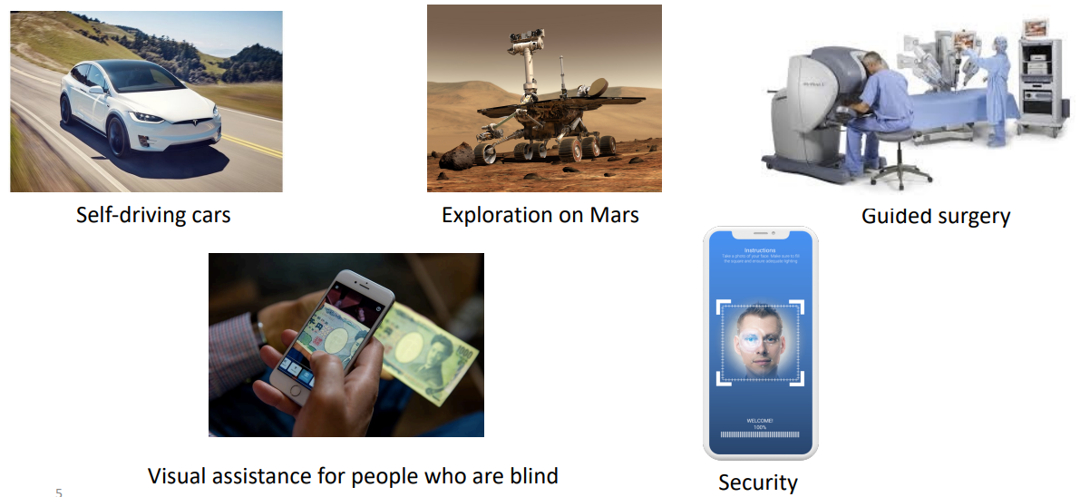
Computer Vision: Computers that "See"
Introduction to Computer Vision and Image Classification
Session 13

Slide 3
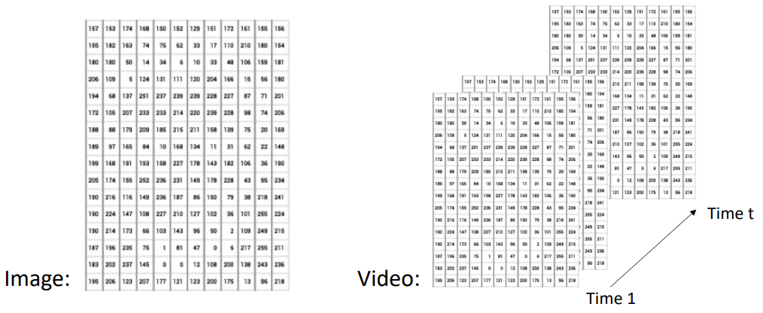
Why Discuss Computer Vision with CNNs?
CNNs have a strong track record for vision problems;
Visual data’s representation (i.e., spatial data) is naturally suited for CNNs.
Introduction to Computer Vision and Image Classification
Session 13

Slide 4
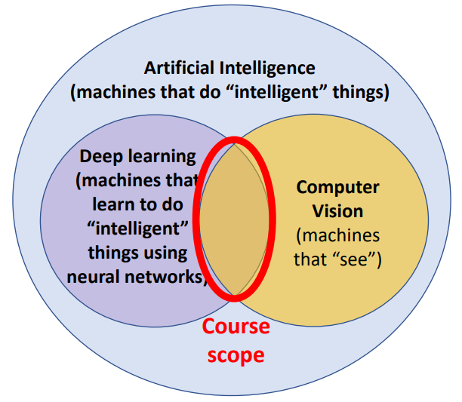
Computer Vision
Introduction to Computer Vision and Image Classification
Session 13

Slide 5
Computer Vision
Key Challenge: Replicate Human Vision for So Much Variation for So Many Tasks!
Object Recognition
Object Detection
Segmentation
Image Captioning
Visual Question Answering
Object Tracking
Subjective Problems
And many more...
Introduction to Computer Vision and Image Classification
Session 13

Slide 6
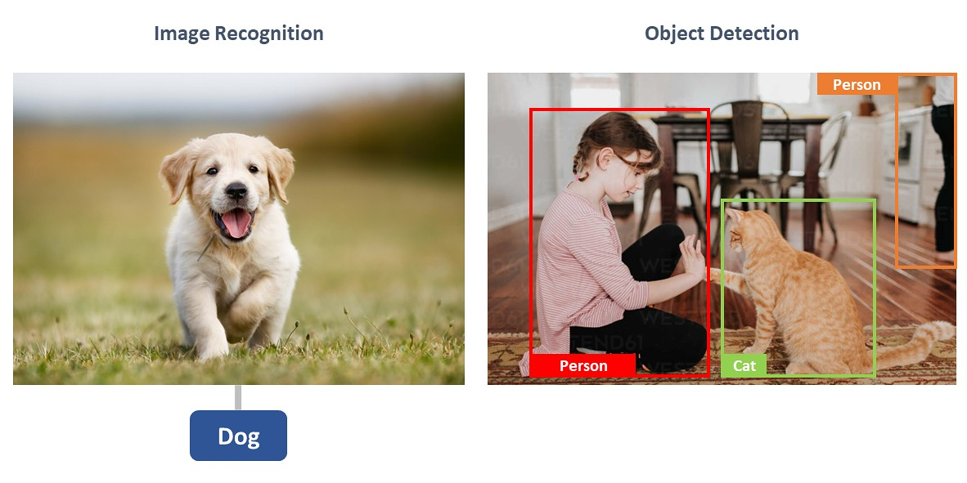
Computer Vision
Key Challenge: Replicate Human Vision for So Much Variation for So Many Tasks!
Object Recognition
Object Detection
Segmentation
Image Captioning
Visual Question Answering
Object Tracking
Subjective Problems
And many more...
Introduction to Computer Vision and Image Classification
Session 13

Slide 7
Computer Vision
Key Challenge: Replicate Human Vision for So Much Variation for So Many Tasks!
Object Recognition
Object Detection
Segmentation
Image Captioning
Visual Question Answering
Object Tracking
Subjective Problems
And many more...
Introduction to Computer Vision and Image Classification
Session 13

Slide 8
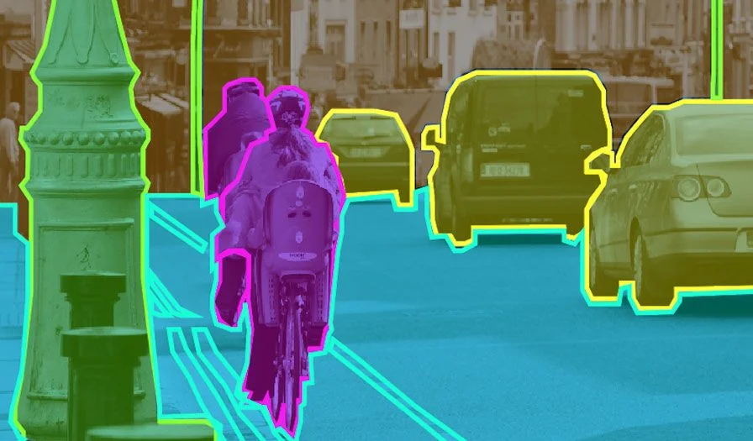
Computer Vision
Key Challenge: Replicate Human Vision for So Much Variation for So Many Tasks!
Object Recognition
Object Detection
Segmentation
Image Captioning
Visual Question Answering
Object Tracking
Subjective Problems
And many more...
Introduction to Computer Vision and Image Classification
Session 13

Slide 9
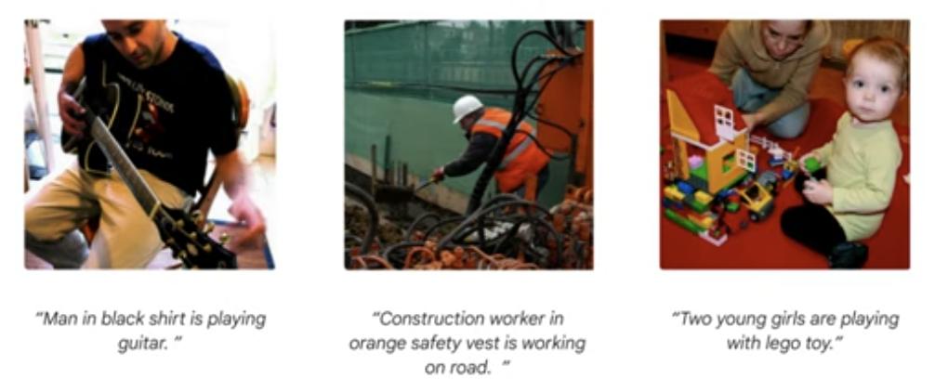
Computer Vision
Key Challenge: Replicate Human Vision for So Much Variation for So Many Tasks!
Object Recognition
Object Detection
Segmentation
Image Captioning
Visual Question Answering
Object Tracking
Subjective Problems
And many more...
Introduction to Computer Vision and Image Classification
Session 13

Slide 10
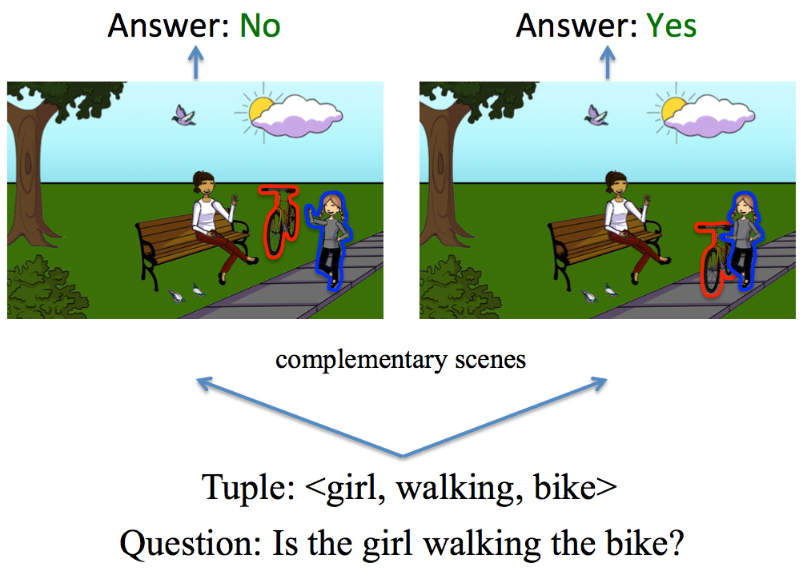
Computer Vision
Key Challenge: Replicate Human Vision for So Much Variation for So Many Tasks!
Object Recognition
Object Detection
Segmentation
Image Captioning
Visual Question Answering
Object Tracking
Subjective Problems
And many more...
Introduction to Computer Vision and Image Classification
Session 13

Slide 11
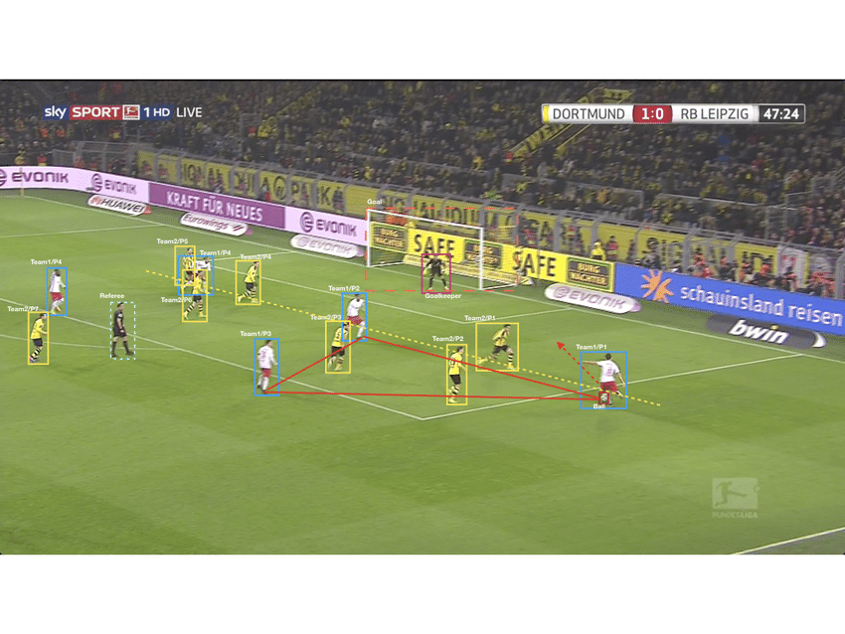
Computer Vision
Key Challenge: Replicate Human Vision for So Much Variation for So Many Tasks!
Object Recognition
Object Detection
Segmentation
Image Captioning
Visual Question Answering
Object Tracking
Subjective Problems
And many more...
Introduction to Computer Vision and Image Classification
Session 13

Slide 12
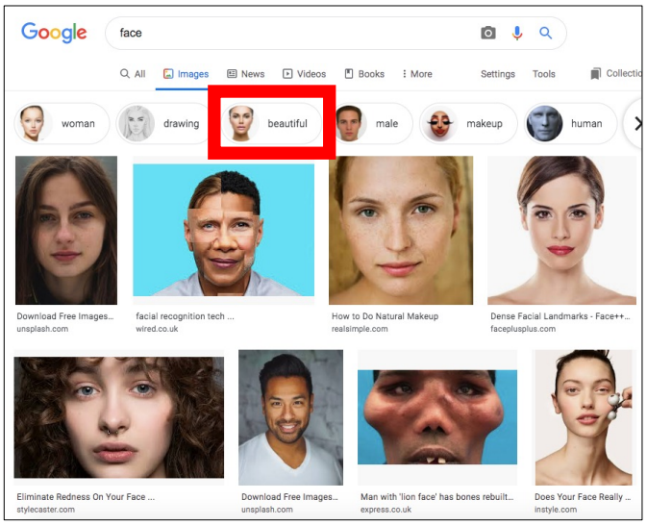
Computer Vision
Key Challenge: Replicate Human Vision for So Much Variation for So Many Tasks!
Object Recognition
Object Detection
Segmentation
Image Captioning
Visual Question Answering
Object Tracking
Subjective Problems
And many more...
Introduction to Computer Vision and Image Classification
Session 13

Slide 13
Computer Vision
Key Challenge: Replicate Human Vision for So Much Variation for So Many Tasks!
Object Recognition
Object Detection
Segmentation
Image Captioning
Visual Question Answering
Object Tracking
Subjective Problems
And many more...
Introduction to Computer Vision and Image Classification
Session 13

Slide 14
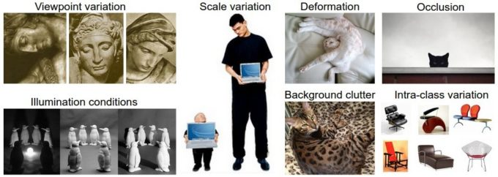
Computer Vision
Key Challenge: Replicate Human Vision for So Much Variation for So Many Tasks!
Introduction to Computer Vision and Image Classification
Session 13

Slide 15

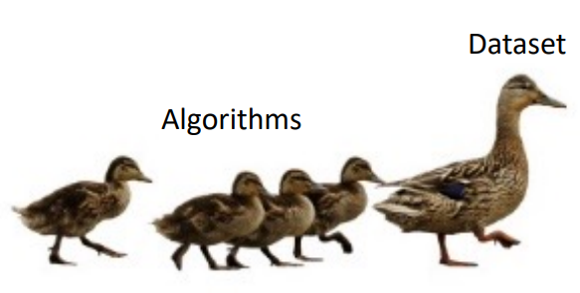
Computer Vision
Through 1990s, datasets tended to be relatively small (e.g., 10s or 100s of examples)
Since 1990s, datasets tend to be large (i.e., thousands to millions of examples)
Introduction to Computer Vision and Image Classification
Session 13

Slide 16
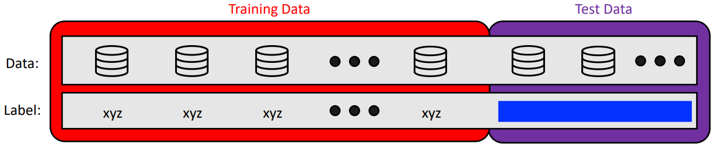
Computer Vision: The Era of Dataset Challenges
What do you think prompted this shift to large-scale datasets?
Progress Charted by Progress on Community Shared Dataset Challenges
1. Dataset split into a “training set” and “test set” with the labels for the “test set” hidden
2. Teams design a model and submit its predictions on the test set to an evaluation server
3. A public leaderboard shows the ranking of performance for all teams’ submitted models
Introduction to Computer Vision and Image Classification
Session 13

Slide 17
Computer Vision: The Era of Dataset Challenges
Why challenges?
Provide fair comparison between models
Create a community around a shared goal
Introduction to Computer Vision and Image Classification
Session 13

Slide 18
Many Public Dataset Challenges Available
Google Dataset Search
Amazon's AWS Datasets
Kaggle Datasets
Wikipedia's List
UC Irvine Machine Learning Repository
Reddit
https://dataportals.org/
Introduction to Computer Vision and Image Classification
Session 13

Slide 19
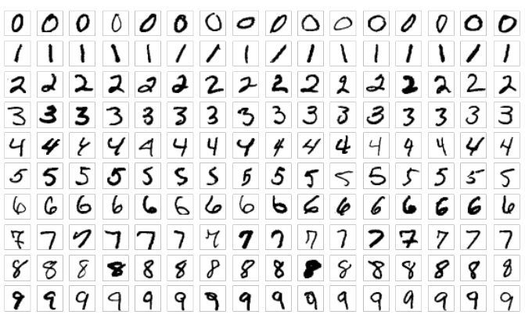
MNIST Challenge
Goal: classify digit as 0, 1, …, or 9
Evaluation metric: accuracy (% correct)
Dataset: 60,000 training and 10,000 test examples, pre-processed to be centered and same dimension; writers were different in the two sets
Source: images collected by NIST from a total of 500 Census Bureau employees and high school students
Introduction to Computer Vision and Image Classification
Session 13

Slide 20
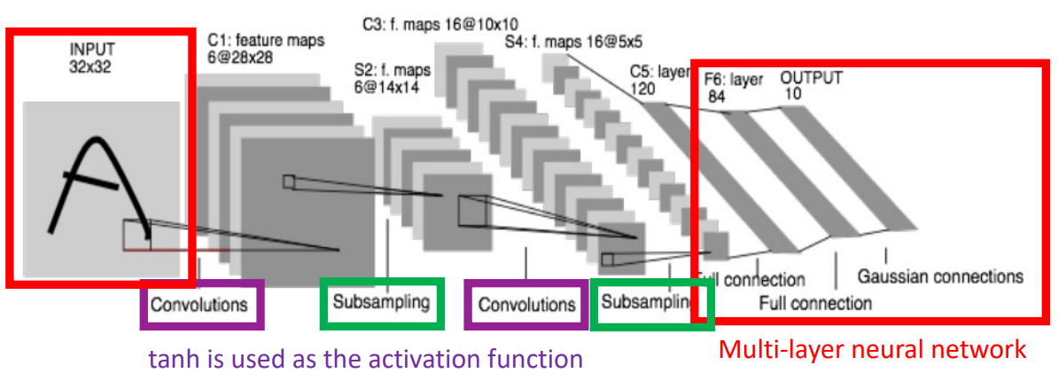
MNIST Challenge Winner: LeNet
LeNet: Architecture (like Neocognitron, has convolutional layers and pooling layers)
Introduction to Computer Vision and Image Classification
Session 13

Slide 21
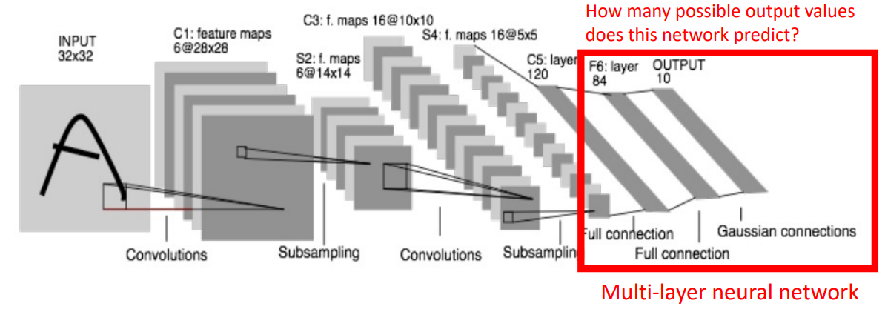
MNIST Challenge Winner: LeNet
Introduction to Computer Vision and Image Classification
Session 13

Slide 22
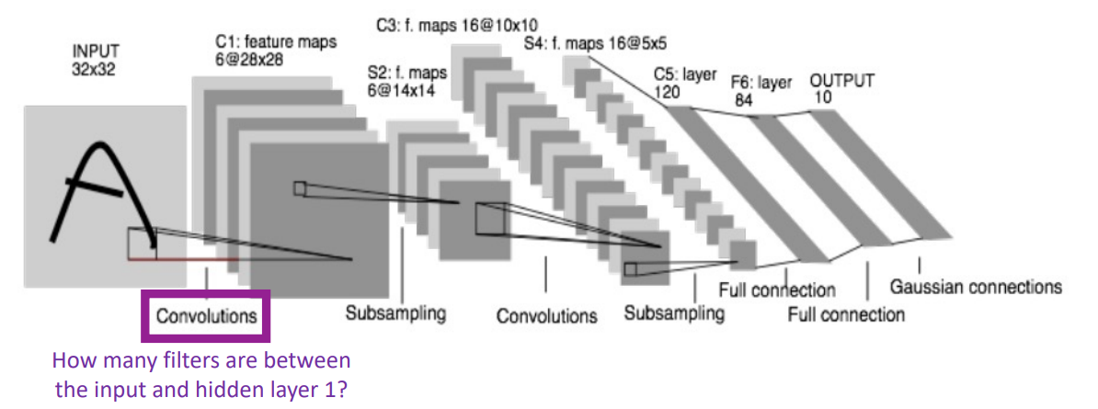
MNIST Challenge Winner: LeNet
Introduction to Computer Vision and Image Classification
Session 13

Slide 23
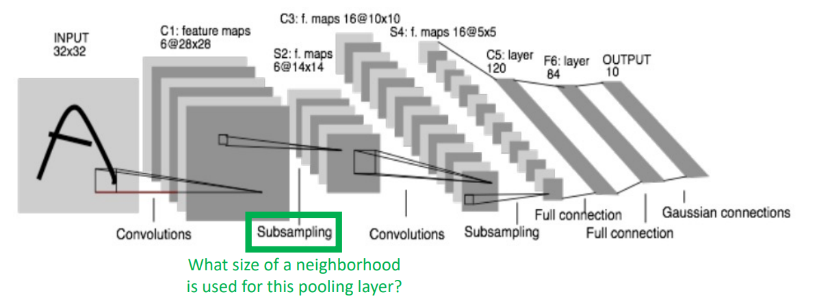
MNIST Challenge Winner: LeNet
Introduction to Computer Vision and Image Classification
Session 13

Slide 24
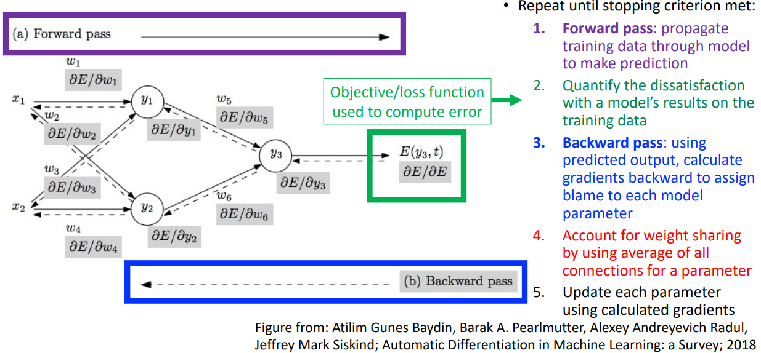
Training Procedure Approach (Key Novelty)
Introduction to Computer Vision and Image Classification
Session 13

Slide 25
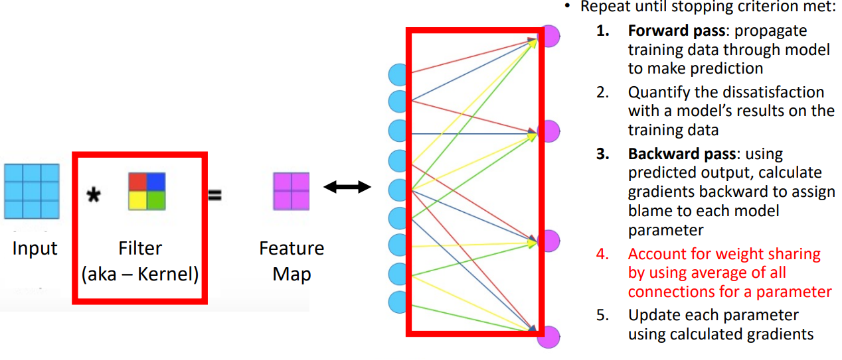
Training Procedure Approach (Key Novelty)
Introduction to Computer Vision and Image Classification
Session 13

Slide 26
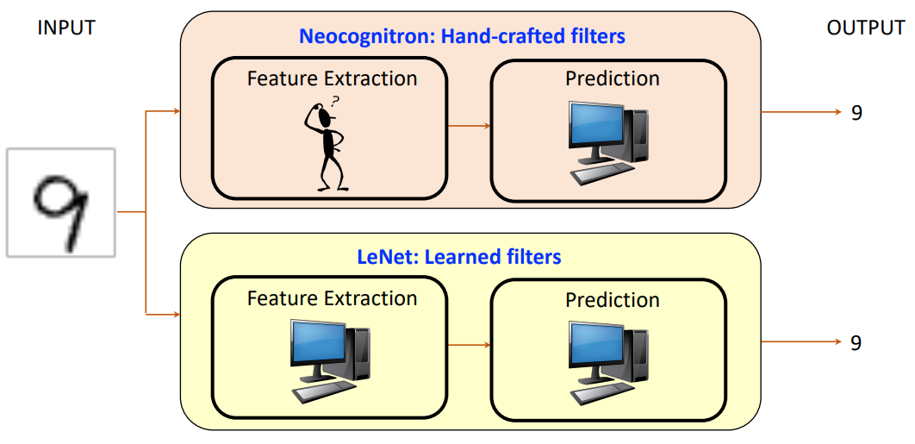
LeNet vs Neocognitron
Introduction to Computer Vision and Image Classification
Session 13

Slide 27
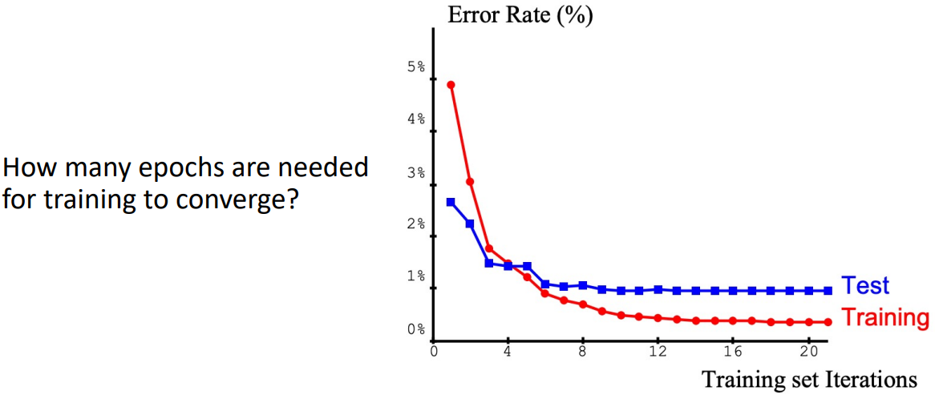
LeNet Performance Analysis
Introduction to Computer Vision and Image Classification
Session 13

Slide 28
LeNet
LeNet, designed on the MNIST Challenge, was used to read over 10% of checks in North America in the 1990s, reading millions of checks every mont!
Introduction to Computer Vision and Image Classification
Session 13

Slide 29
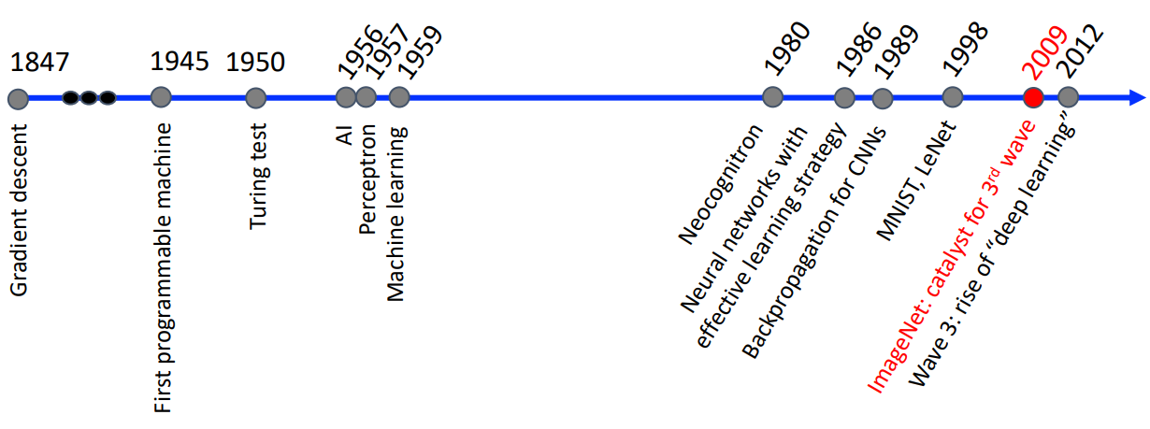
Historical Context
Introduction to Computer Vision and Image Classification
Session 13

Slide 30

ImageNet: Predict Category from 1000 Options
Evaluation metric: % correct (top-1 and top-5 predictions)
Dataset: ~1.5 million images
Source: images scraped from search engines, such as Flickr, and labeled by crowdworkers
Introduction to Computer Vision and Image Classification
Session 13

Slide 31
ImageNet vs MNISt
3D objects in natural backgrounds
Many more categories
Introduction to Computer Vision and Image Classification
Session 13

Slide 32
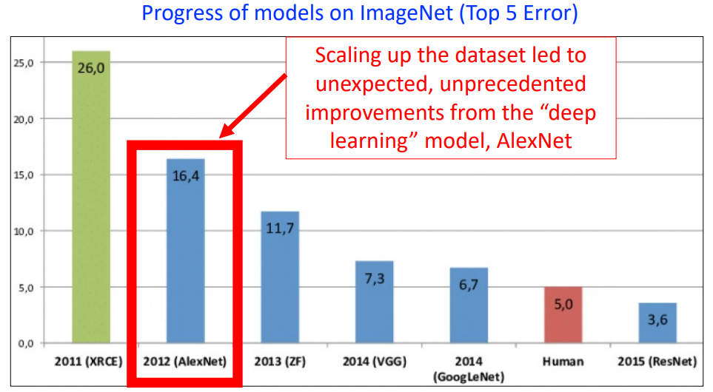
Rise of Deep Learning
Introduction to Computer Vision and Image Classification
Session 13

Slide 33
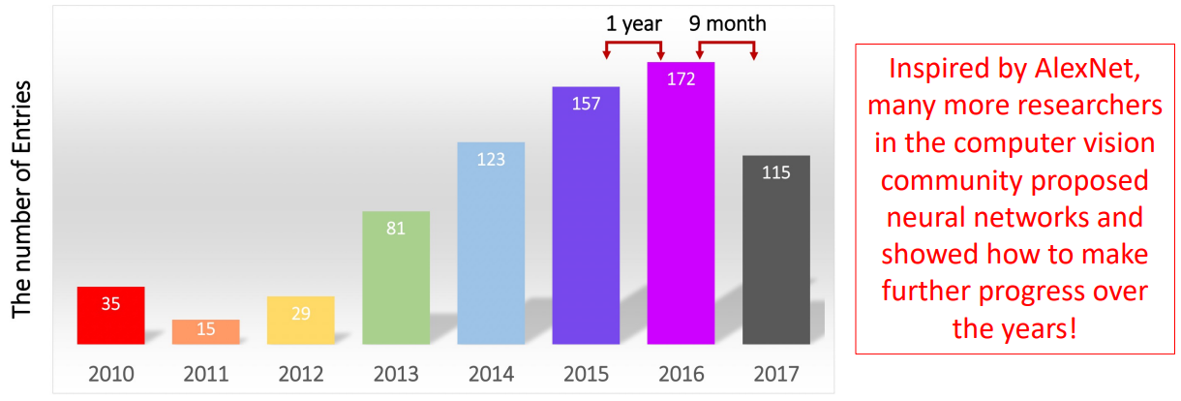
Rise of Deep Learning Following AlexNet
Introduction to Computer Vision and Image Classification
Session 13

Slide 34
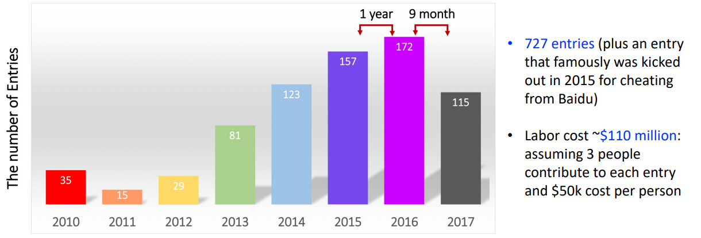
Rise of Deep Learning Following AlexNet
Introduction to Computer Vision and Image Classification
Session 13

Slide 35
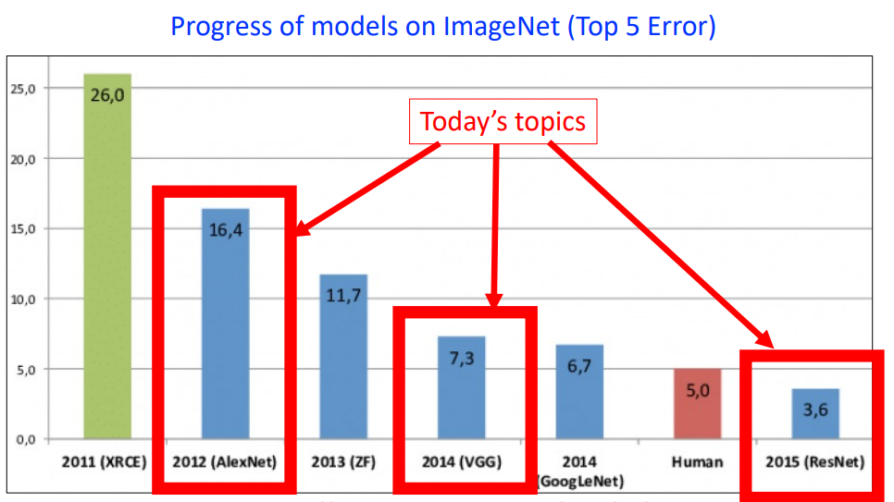
Secret Sauce for State-of-Art: Deeper CNNs
Introduction to Computer Vision and Image Classification
Session 13

Slide 36
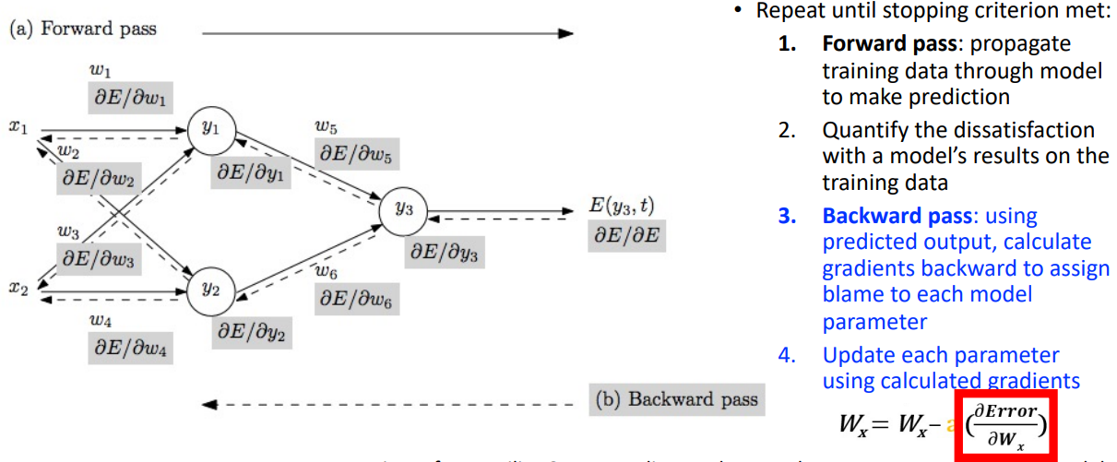
The Problem of the Vanishing Gradients
Why It Is Difficult to Achieve Better Performance with CNNs That Are Deeper?
Introduction to Computer Vision and Image Classification
Session 13

Slide 37
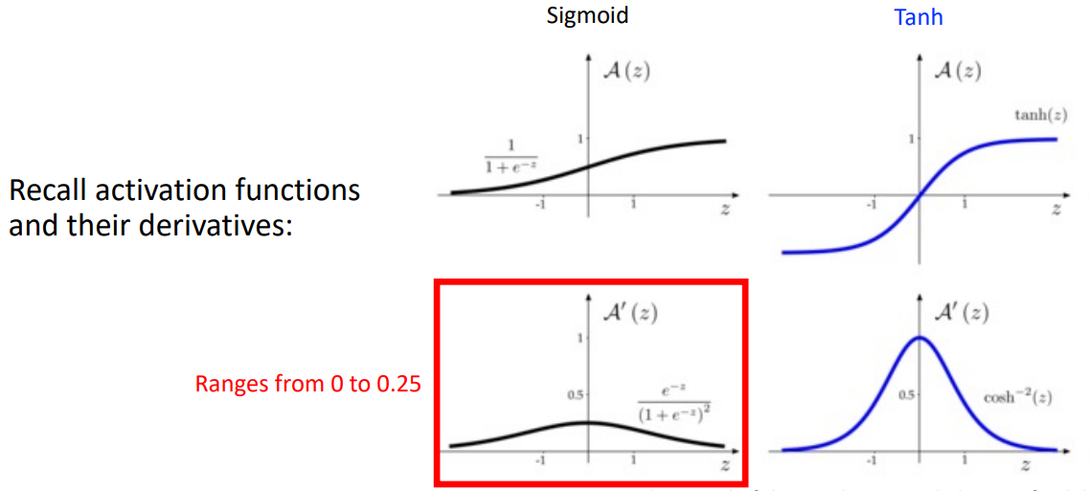
The Problem of the Vanishing Gradients
Introduction to Computer Vision and Image Classification
Session 13

Slide 38
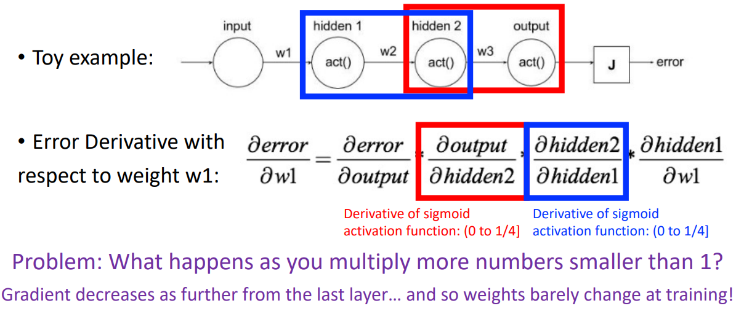
The Problem of the Vanishing Gradients
Sigmoid Example
Introduction to Computer Vision and Image Classification
Session 13

Slide 39
The Problem of the Vanishing Gradients
How can we avoid the vanishing gradient problem?
Introduction to Computer Vision and Image Classification
Session 13

Slide 40
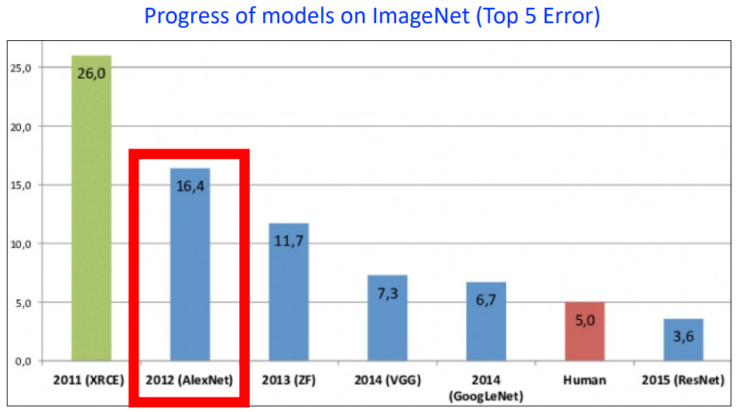
AlexNet: A Deeper CNN
Introduction to Computer Vision and Image Classification
Session 13

Slide 41
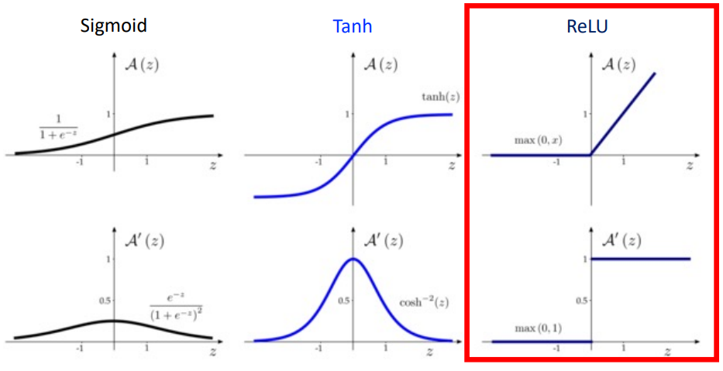
How can we avoid the vanishing gradients problem?
Use non-saturating activation functions:
Use activation functions with derivative value equal to 1 (i.e., 1x1x1… doesn’t vanish)
Introduction to Computer Vision and Image Classification
Session 13

Slide 42
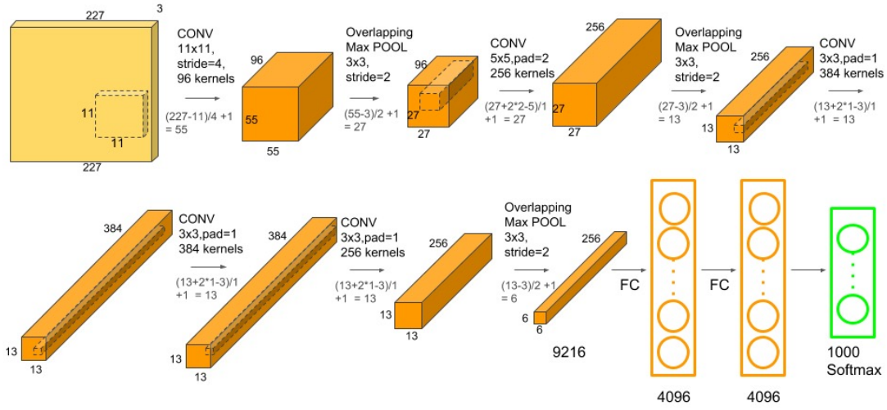
AlexNet Architecture
Similar to LeNet But With More Convolutional and Pooling Layers
Introduction to Computer Vision and Image Classification
Session 13

Slide 43
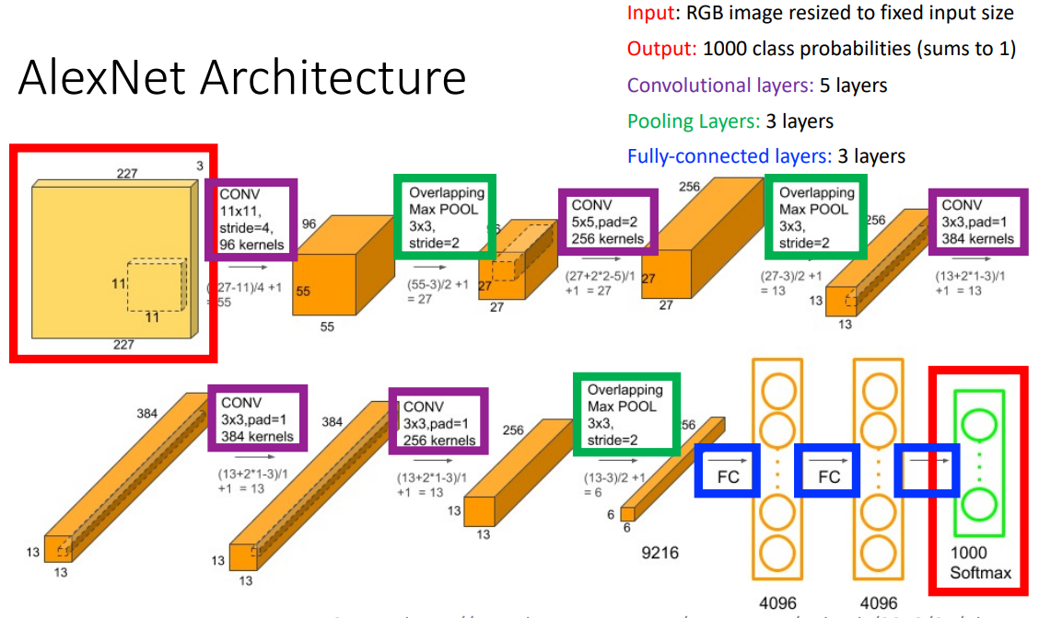
AlexNet Architecture
Introduction to Computer Vision and Image Classification
Session 13

Slide 44
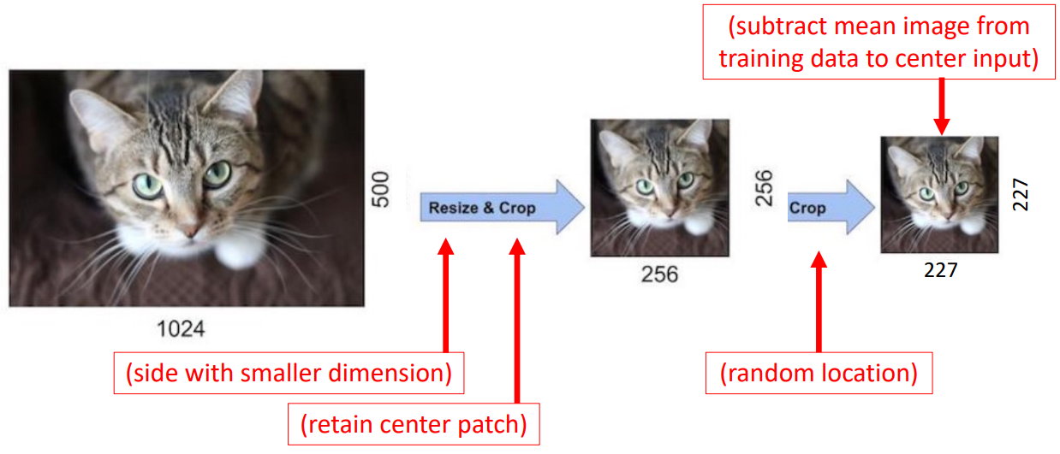
AlexNet: Input Preprocessing
Introduction to Computer Vision and Image Classification
Session 13

Slide 45
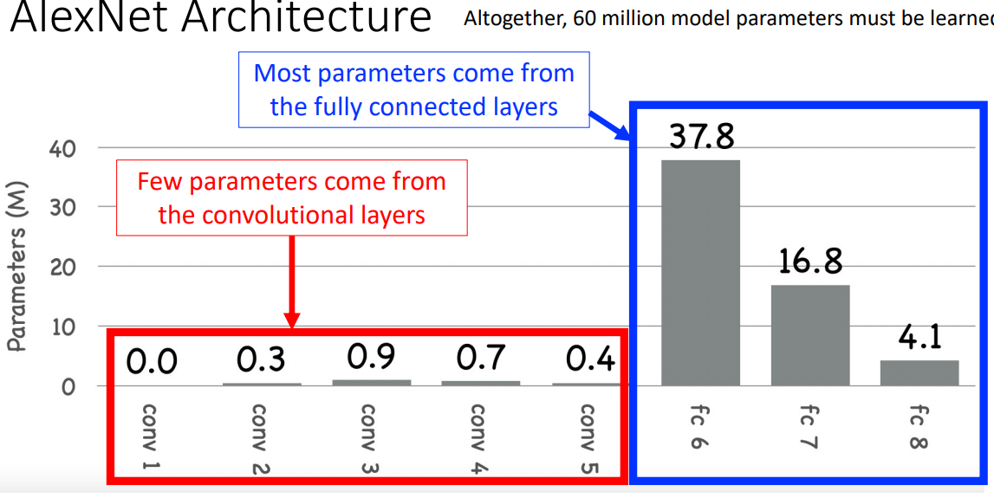
AlexNet Architecture
Introduction to Computer Vision and Image Classification
Session 13

Slide 46
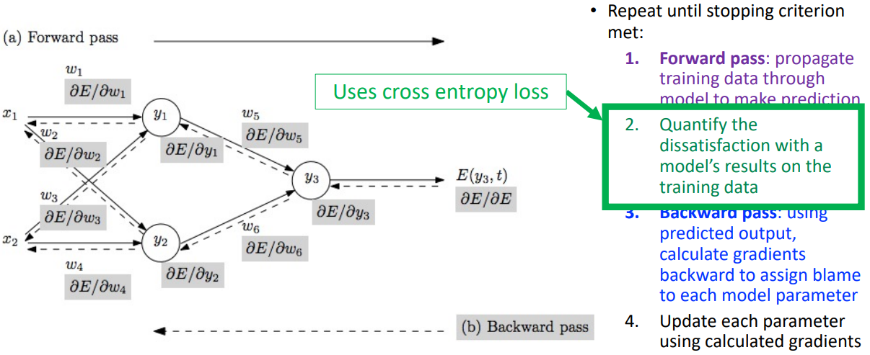
AlexNet Training: 90 Epochs
Introduction to Computer Vision and Image Classification
Session 13

Slide 47
AlexNet: Key Tricks for Going Deeper
ReLU instead of sigmoid or tanh activation functions
Regularization techniques
Data augmentation
Dropout in fully connected layers
L2 parameter norm penalty
Trained across 2 GPUs
Introduction to Computer Vision and Image Classification
Session 13

Slide 48
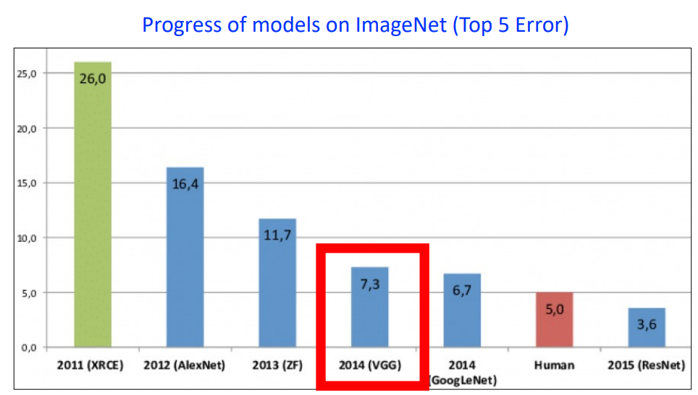
VGG: A Even Deeper CNN
Introduction to Computer Vision and Image Classification
Session 13

Slide 49
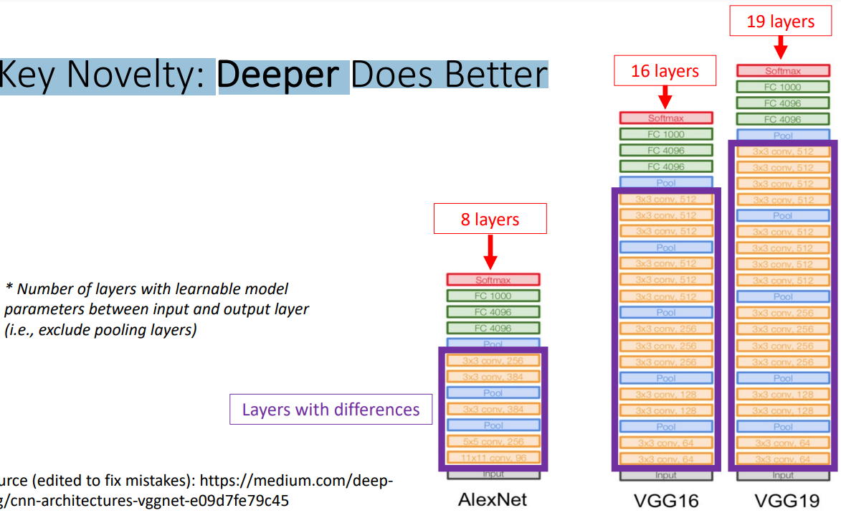
VGG
Key Novelty: Deeper Does Better
Introduction to Computer Vision and Image Classification
Session 13

Slide 50
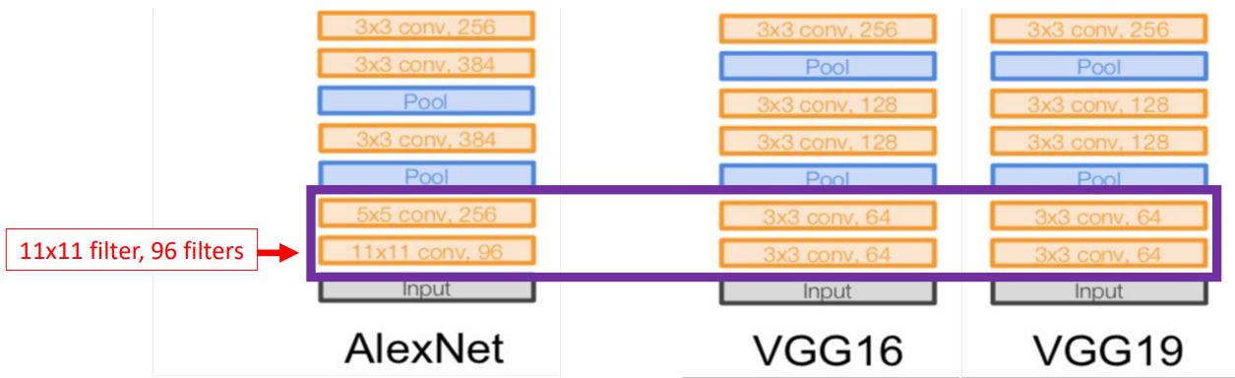
VGG
Replace larger filter with stack of smaller filters
Introduction to Computer Vision and Image Classification
Session 13

Slide 51
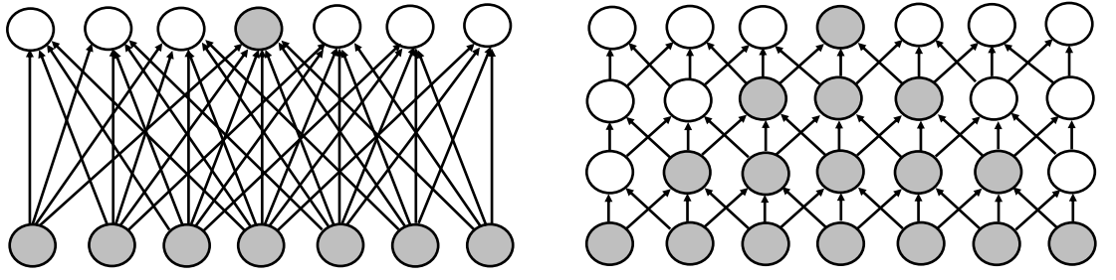
VGG
Replace larger filter with stack of smaller filters; e.g., replace 7x7 with three 3x3s
Benefits:
More discriminative classifier since more non-linear rectifications: 3 vs 1
Reduces # of parameters: multiple of 27 (3 x 32) parameters vs 49 (7 x 7) parameters
Introduction to Computer Vision and Image Classification
Session 13

Slide 52
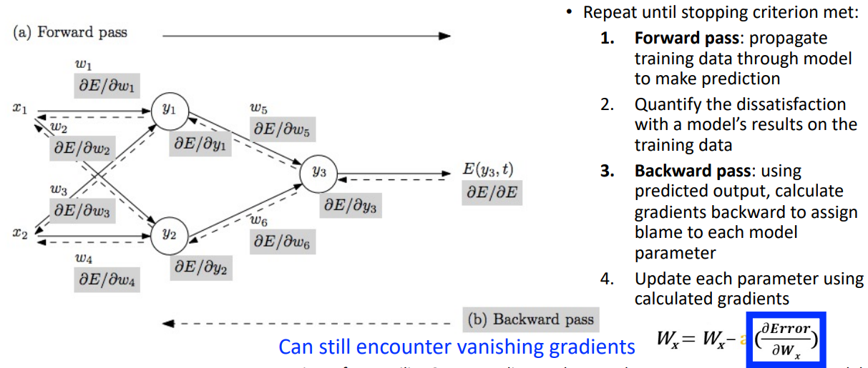
VGG Training (Similar to AlexNet): 74 Epochs
Introduction to Computer Vision and Image Classification
Session 13

Slide 53
Weight Initialization
Problem: vanishing gradients can occur since derivative expression contains weight multiplication, and weights are generally initialized to < 1
Solution: Strategic initialization of weights
Methods like Xavier or He initialization scale weights based on layer size.
This keeps activations and gradients stable across layers.
Introduction to Computer Vision and Image Classification
Session 13

Slide 54
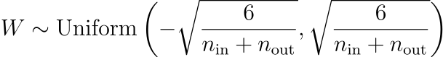
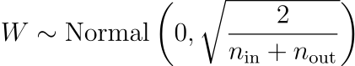
Xavier Initialization
For a given layer with n_{in} input units and n_{out} output units:
Weights are drawn from a uniform distribution between:
Alternatively, weights can be drawn from a normal distribution with:
Introduction to Computer Vision and Image Classification
Session 13

Slide 55
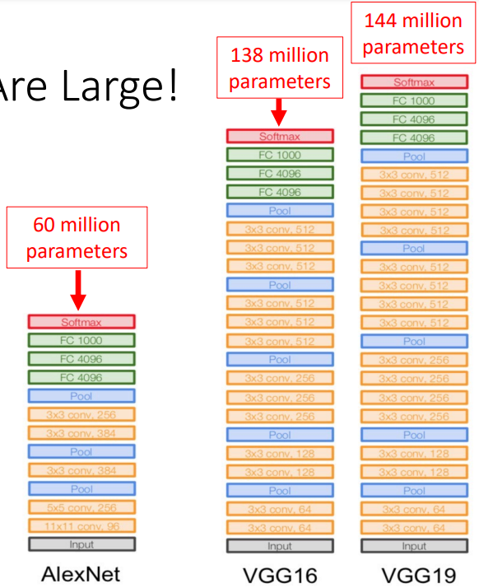
VGG Limitation
Models are large!
Introduction to Computer Vision and Image Classification
Session 13

Slide 56
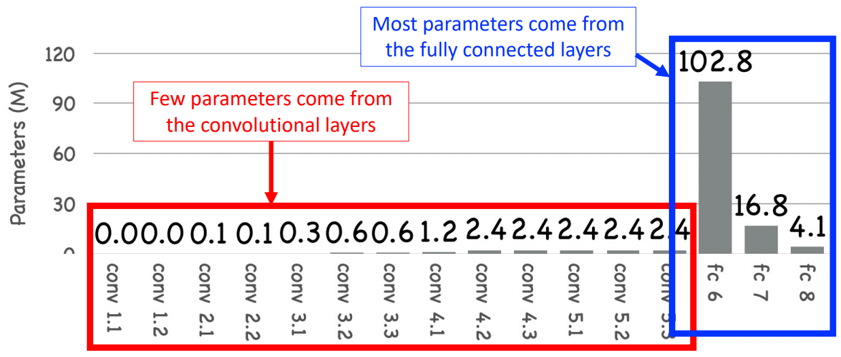
VGG Limitation
Introduction to Computer Vision and Image Classification
Session 13

Slide 57
VGG: Key Tricks for Going Deeper
3x3 filters instead of larger filters
Weight initialization with Xavier Glorot procedure
Regularization techniques
Data augmentation
Dropout in fully connected layers
L2 parameter norm penalty
Trained across multiple GPUs
Introduction to Computer Vision and Image Classification
Session 13

Slide 58
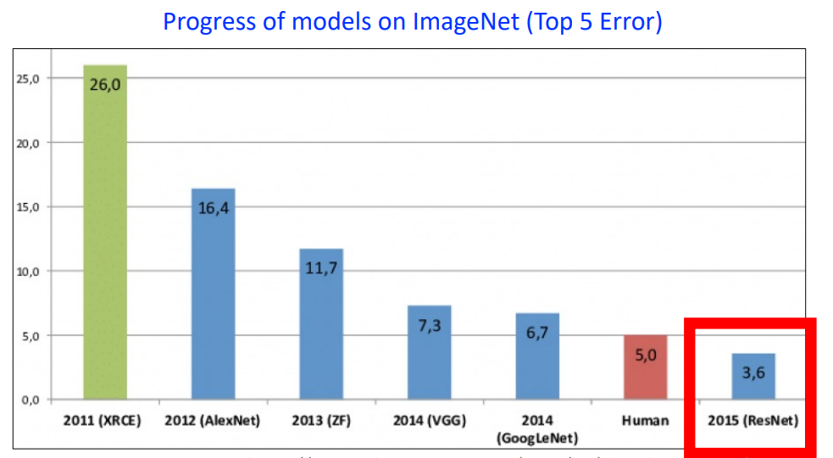
ResNet: A Even Even Deeper CNN
Introduction to Computer Vision and Image Classification
Session 13

Slide 59
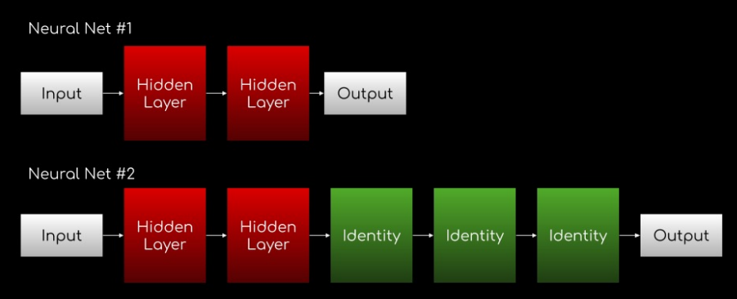
Motivation for ResNet
Idea: a deeper network should perform as good if not better than shallower networks since they can learn the shallower function by simply learning “identity” functions for later layers
Observation: adding more layers leads to WORSE results!
Is the problem overfitting?
Introduction to Computer Vision and Image Classification
Session 13

Slide 60
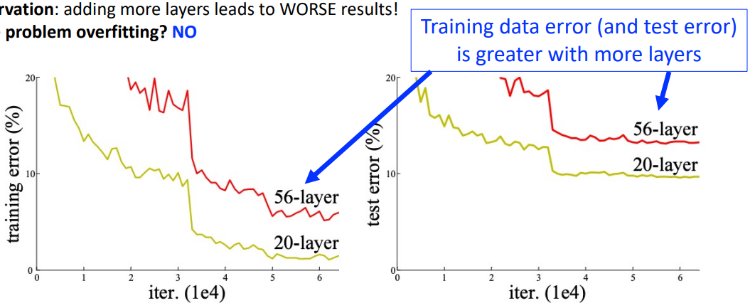
Motivation for ResNet
Is the problem overfitting? NO
Introduction to Computer Vision and Image Classification
Session 13

Slide 61
Motivation for ResNet
Idea: a deeper network should perform as good if not better than shallower networks since they can learn the shallower function by simply learning “identity” functions for later layers
Observation: adding more layers leads to WORSE results!
Is the problem overfitting?
Problem: It is difficult to learn for the algorithm to learn layers of identity mappings
Introduction to Computer Vision and Image Classification
Session 13

Slide 62
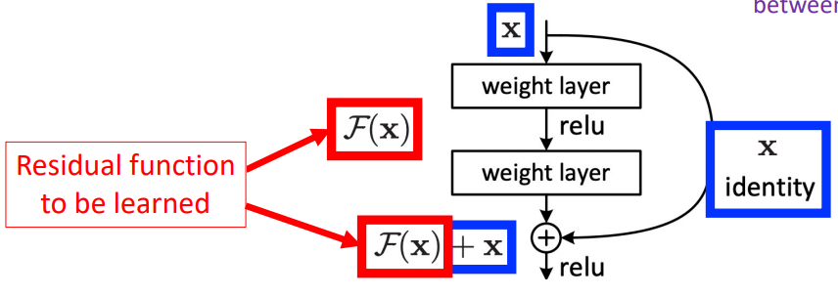
ResNet: Skip Connections
Skip Connection allows the model to learn the identity functions which ensures the higher layer will perform at least as good as the lower layer, and not worse.
Introduction to Computer Vision and Image Classification
Session 13

Slide 63
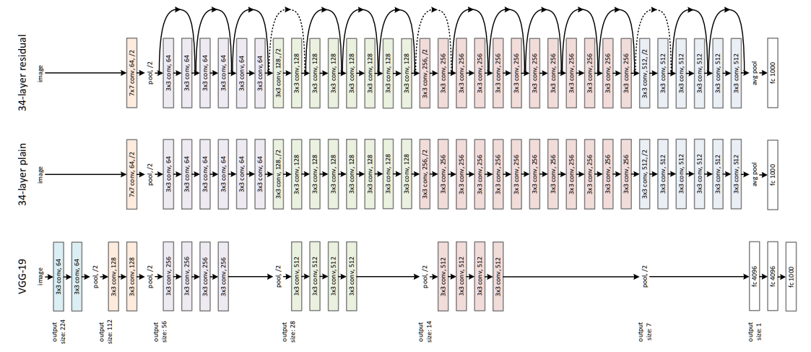
ResNet
Introduction to Computer Vision and Image Classification
Session 13

Slide 64

Experimental Results on Validation Set
Introduction to Computer Vision and Image Classification
Session 13

Slide 65
ResNet: Key Tricks for Going Deeper
Skip Connections
Introduction to Computer Vision and Image Classification
Session 13

Slide 66

Deeper Model Perform Better
Introduction to Computer Vision and Image Classification
Session 13

